Slide 1
Volumetric Frequency Histogram Coarse Graining
Sanyam * Stefano
May 11th 2023

Slide 2
Updated FHCG Function
Check Notes / Notebook

Slide 3
Rule Used (same for all following simulations)
rule = [[(0.451, 0.713, 0), (0.449, 0.663, 1), (0.191, 0.52, 1), (0.089, 0.296, 0)], [(0.332, 0.51, 0), (0.084, 0.307, 0), (0.182, 0.465, 1)], [(0.799, 0.902, 0), (0.303, 0.456, 0), (0.835, 0.984, 1)]]

Slide 4
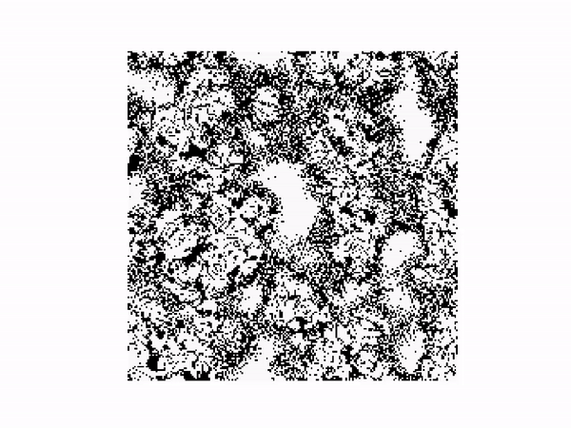
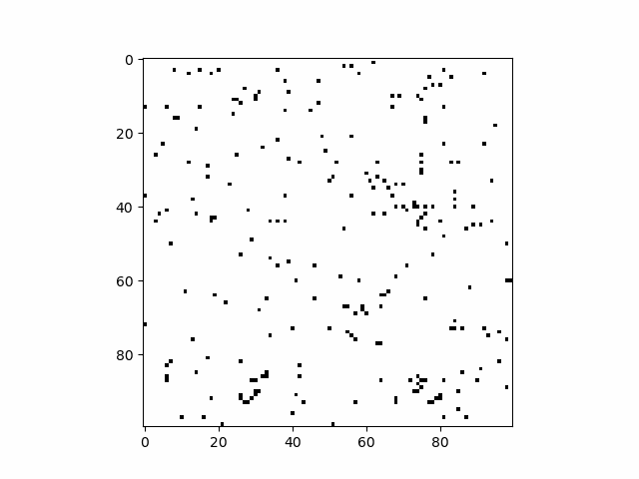
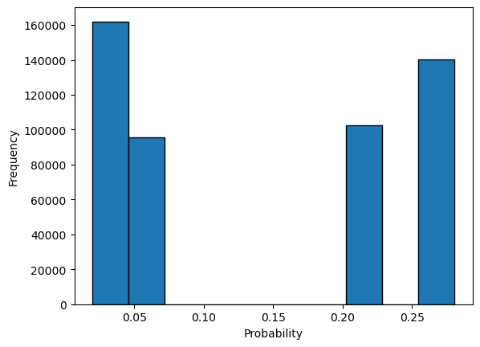
FHCG 0.003

Slide 5
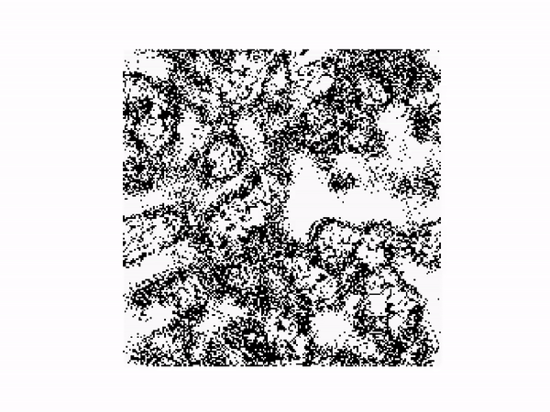
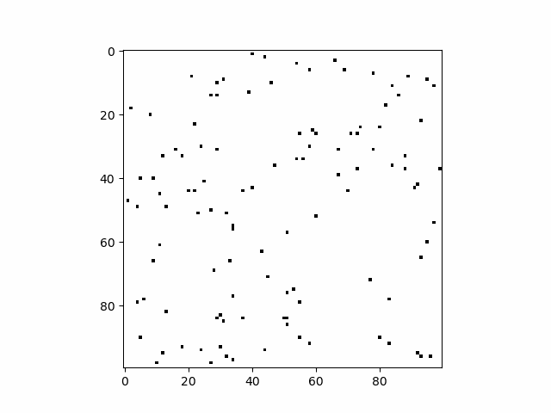
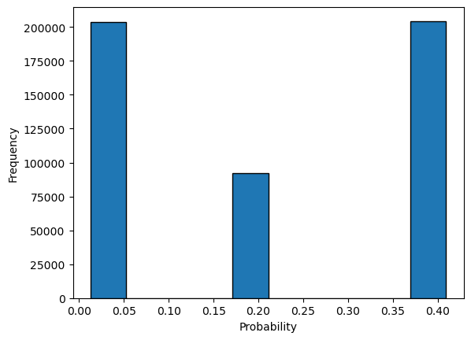
FHCG 0.013

Slide 6
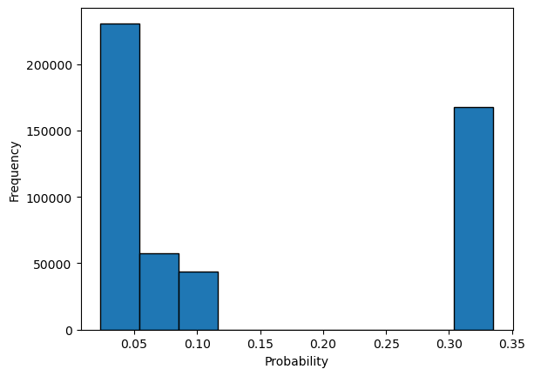
FHCG 0.023 (Experiment did not run successfully)

Slide 7
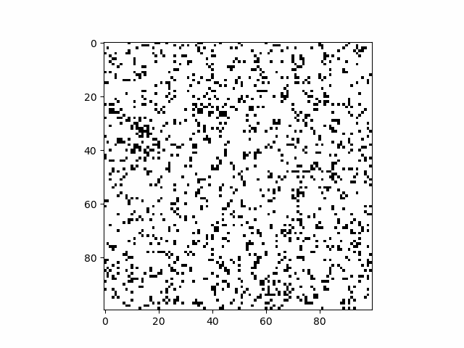
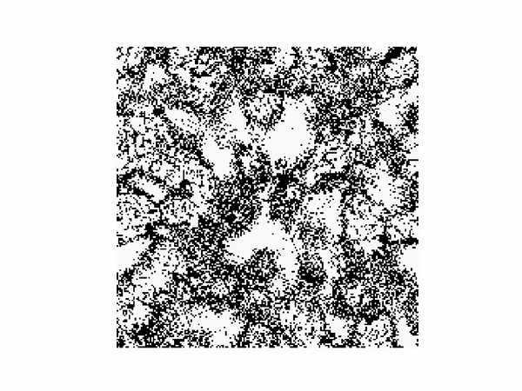

FHCG 0.033

Slide 8
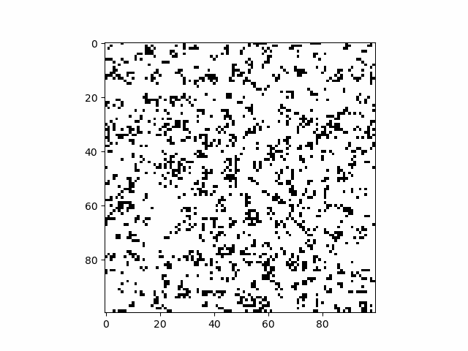
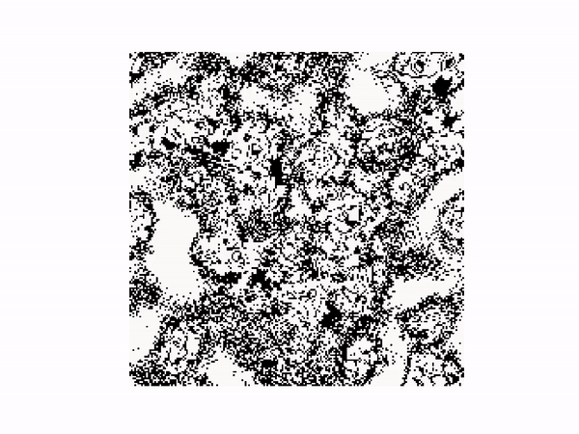
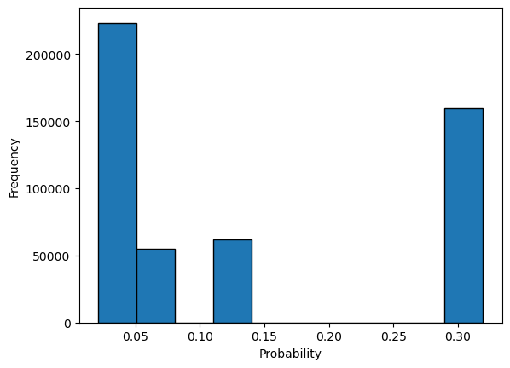
FHCG 0.045

Slide 9
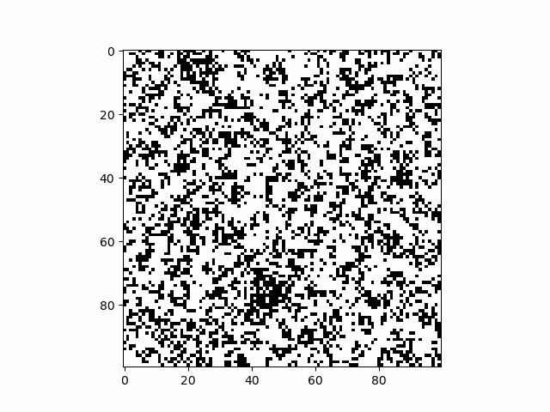
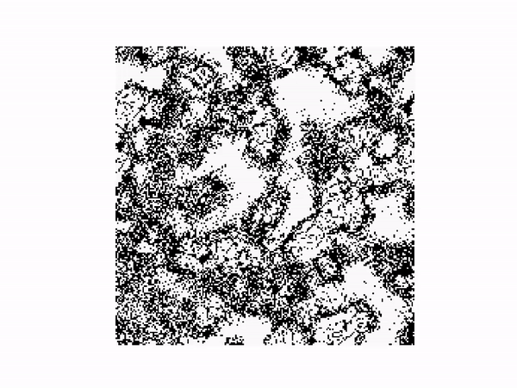
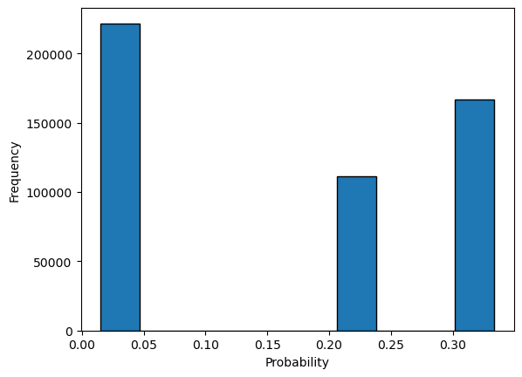
FHCG 0.053

Slide 10
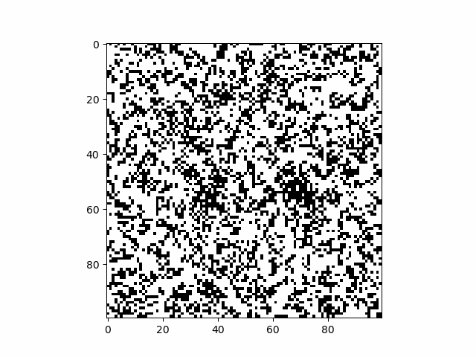
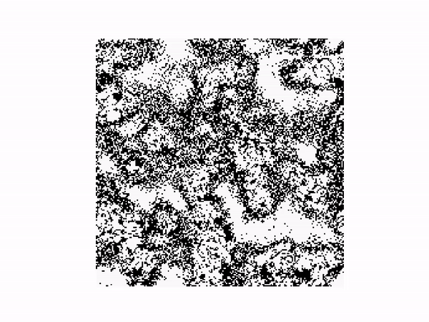
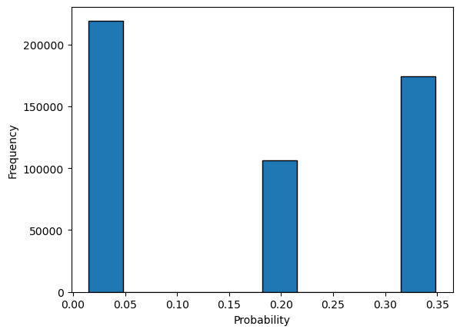
FHCG 0.063

Slide 11
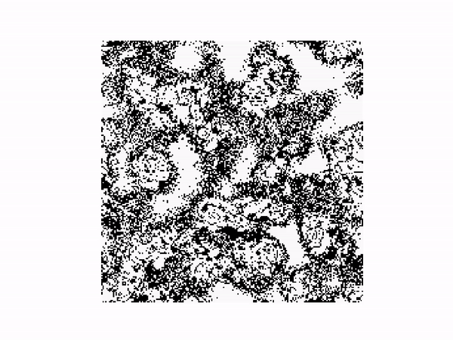
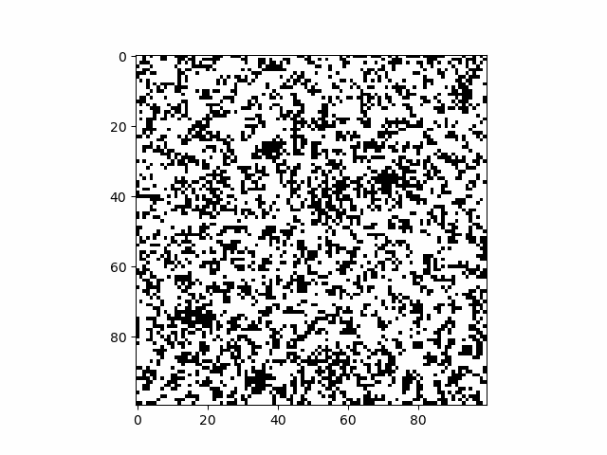
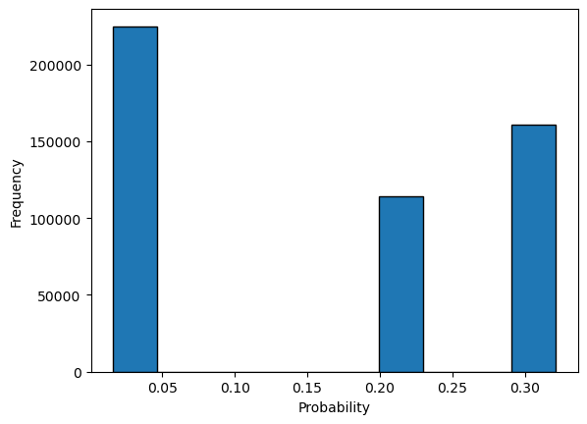
FHCG 0.073

Slide 12
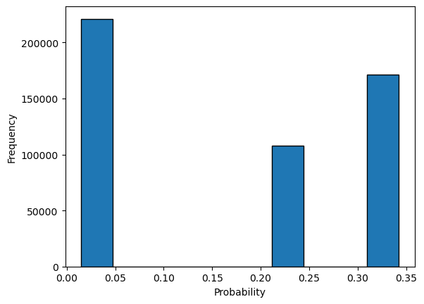
FHCG 0.83 (Experiment did no run successfully)

Slide 13
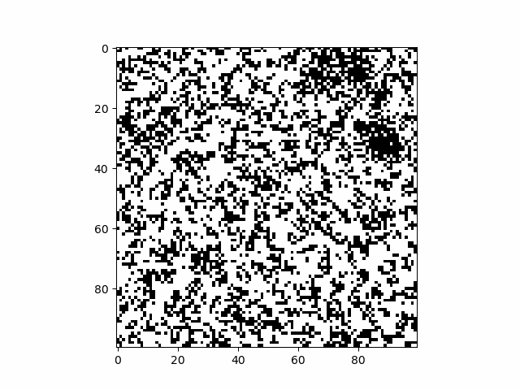
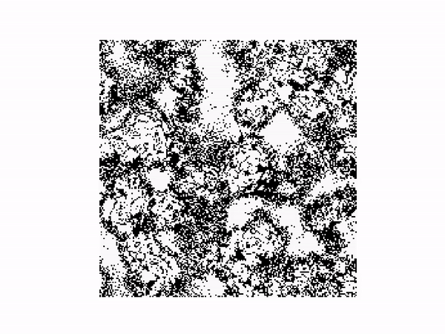
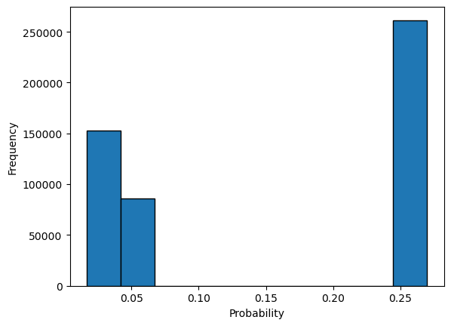
FHCG 0.093

Slide 14
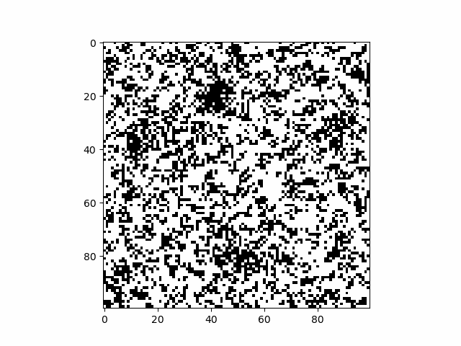
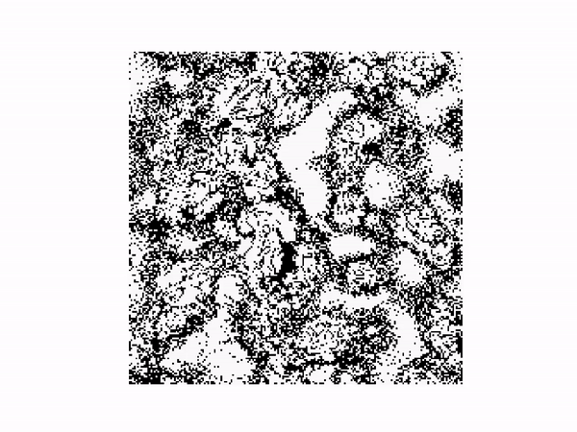
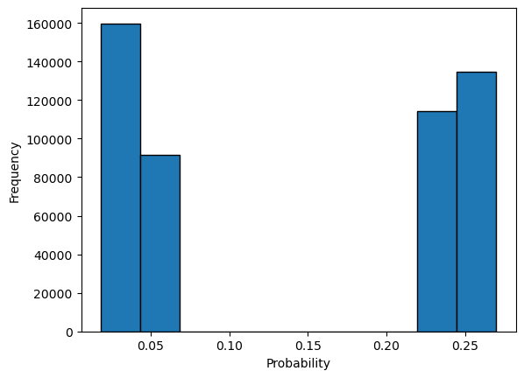
FHCG 0.103

